Slide 1
Property Inspection Demo
Preparation and Walkthrough

Slide 2
Preparing Calendars
Log into OWA with Ron Gabel and delete all calendar invites for the day after the demo. For example, if you are doing the demo on the October 28 then delete all entries on the October 29.

Slide 3
Walkthrough
These following slides describe how to execute the demo, the lists items that are modified during each step, and the emails which are sent.

Slide 4
Inspection Walkthrough

Slide 5
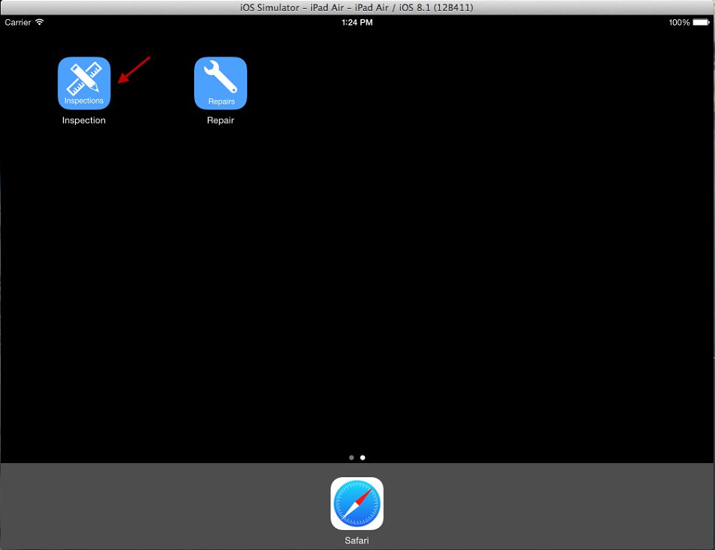
Open Inspection App On iPad

Slide 6
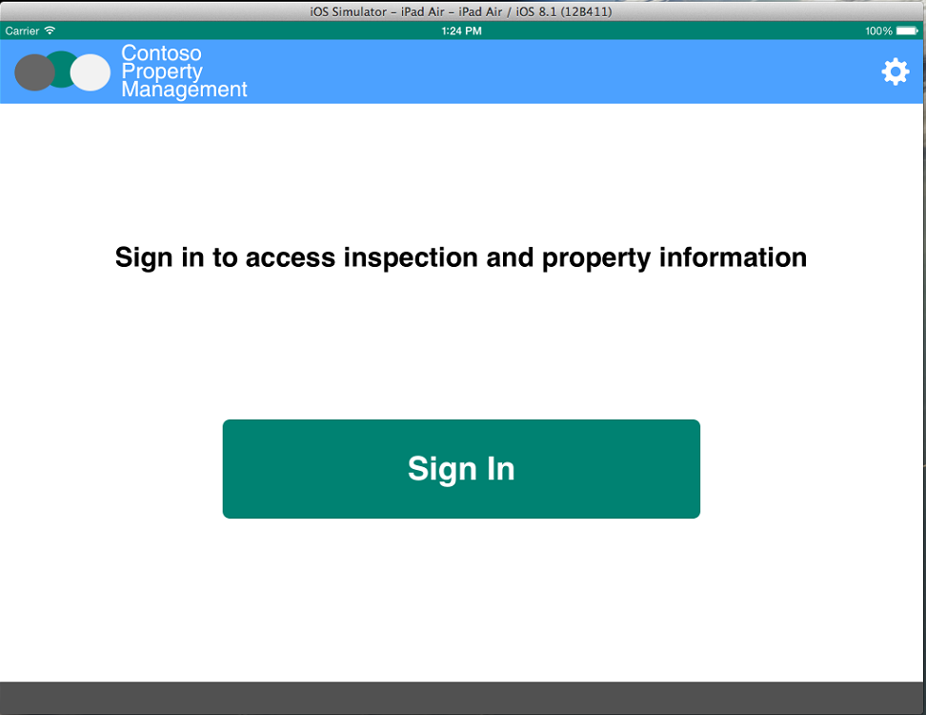
Click Sign In

Slide 7
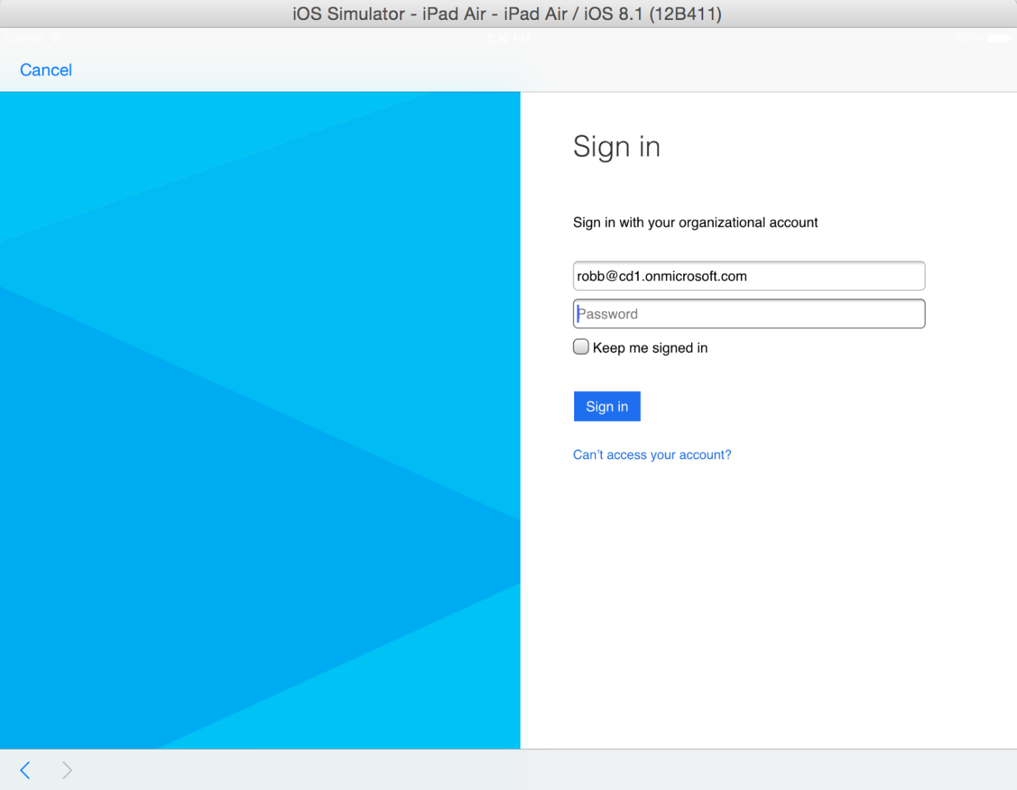
Enter Inspector Credentials Username: robb@<tenanacy>.onmicrosoft.com Password: TempP@ssw0rd! Do not check Keep Me Signed In Click Sign In If you have not already signed in with this user you will be prompted to reset the user’s password.

Slide 8
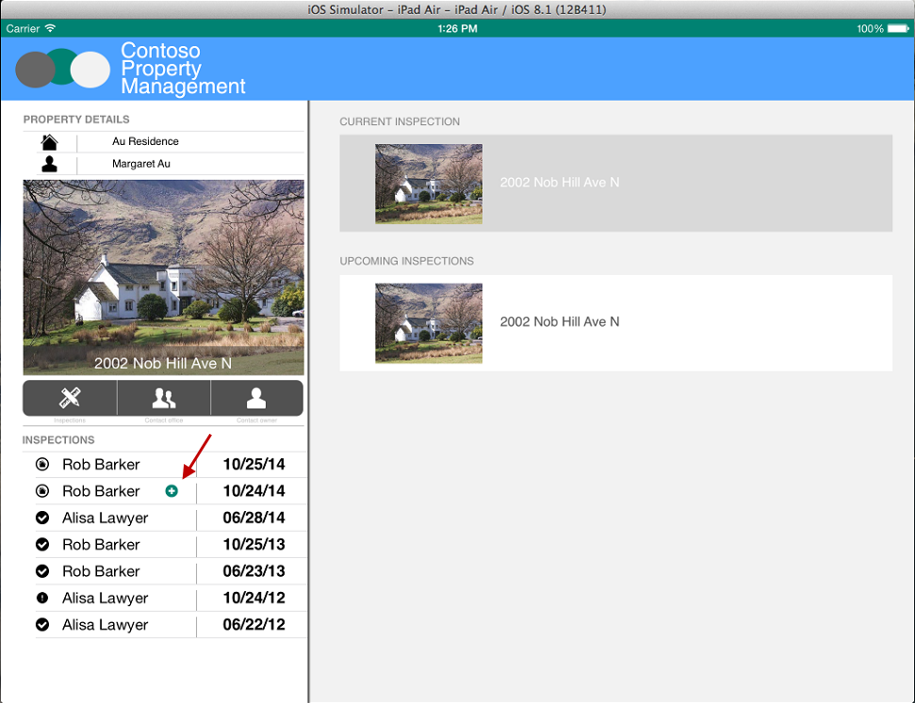
Click Inspection With Plus Icon

Slide 9
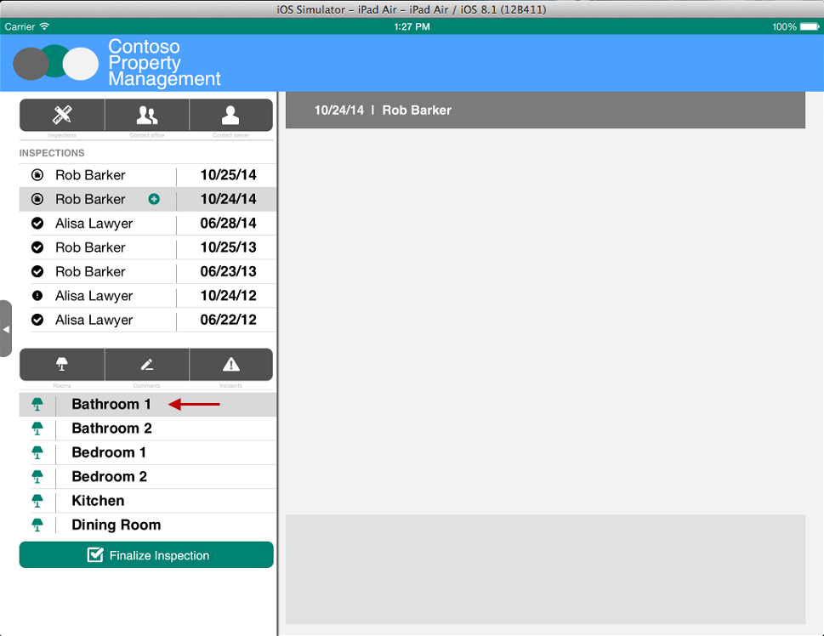
Select Bathroom 1

Slide 10
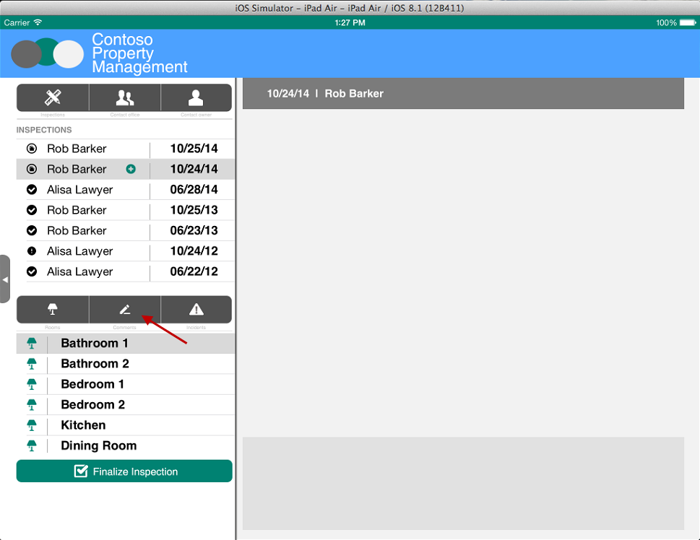
Click Comments

Slide 11
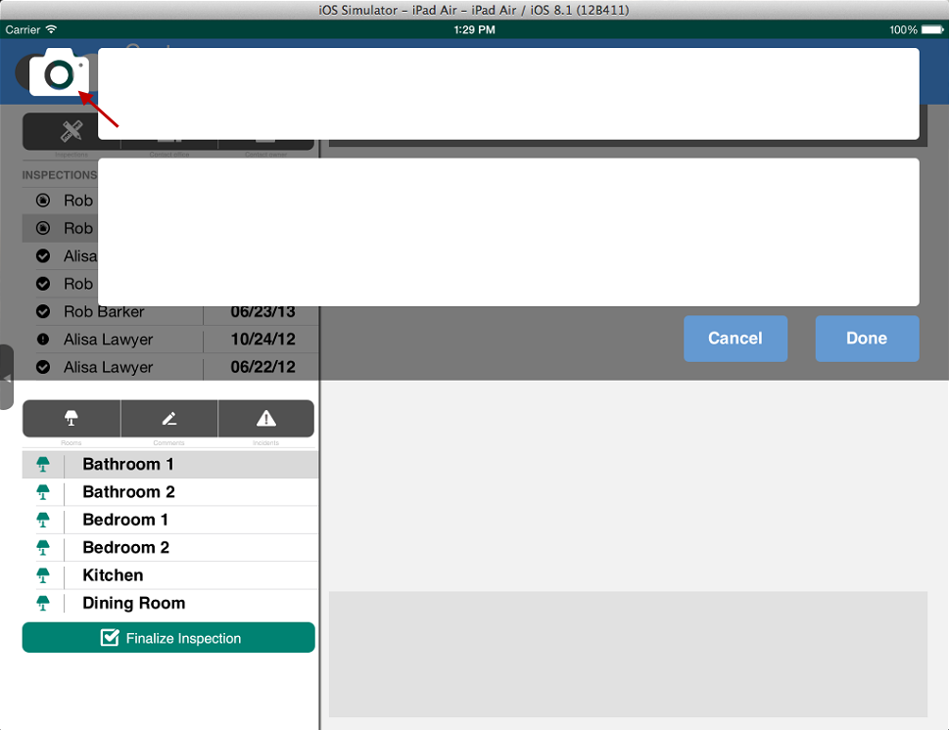
Click Camera

Slide 12
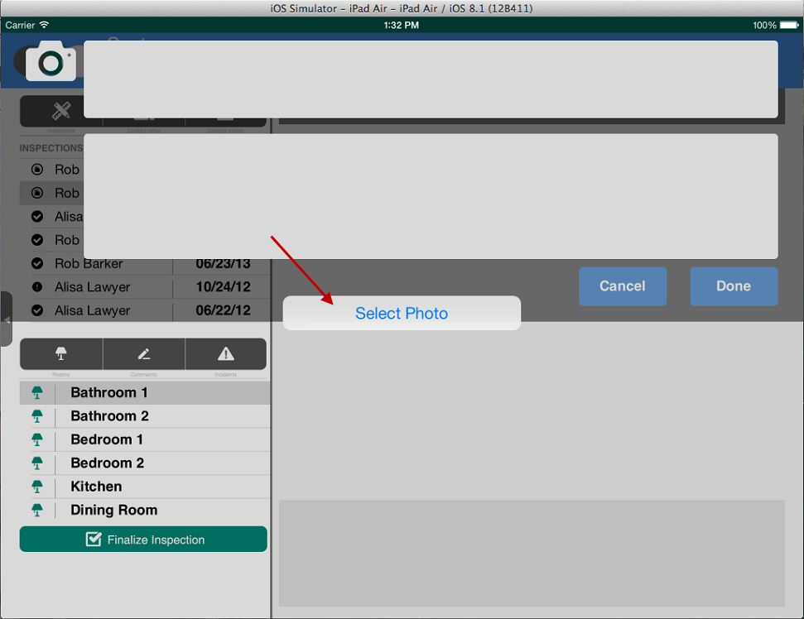
Select Photo On Simulator Or Take Picture On iPad

Slide 13
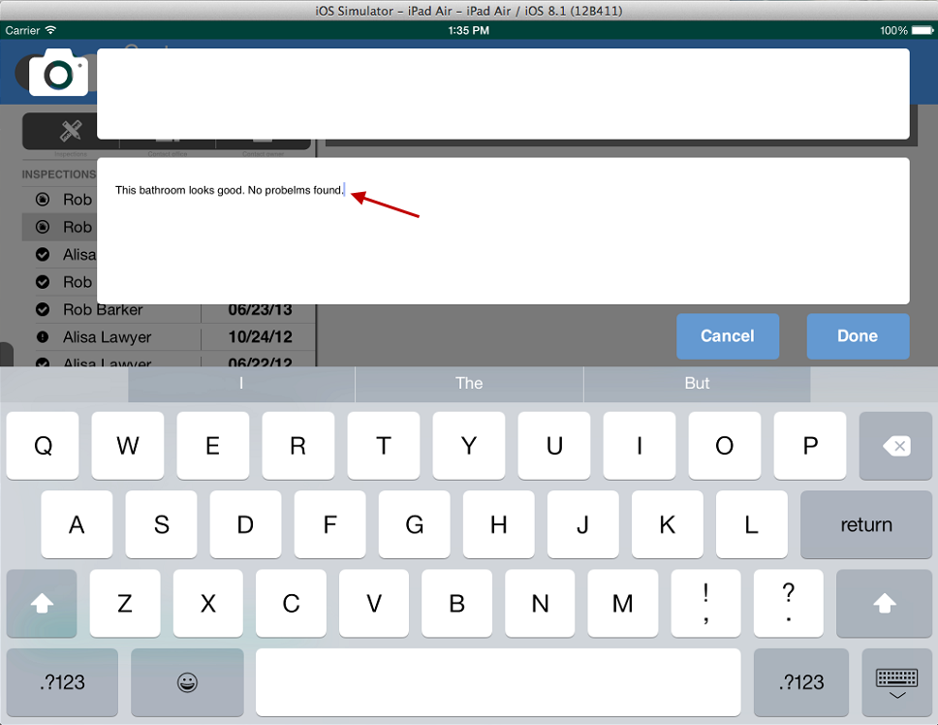
Enter Comments

Slide 14
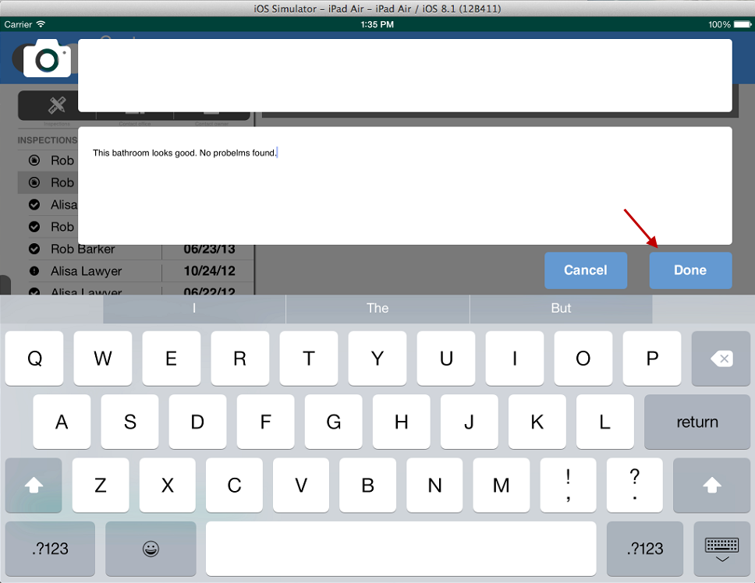
Click Done

Slide 15
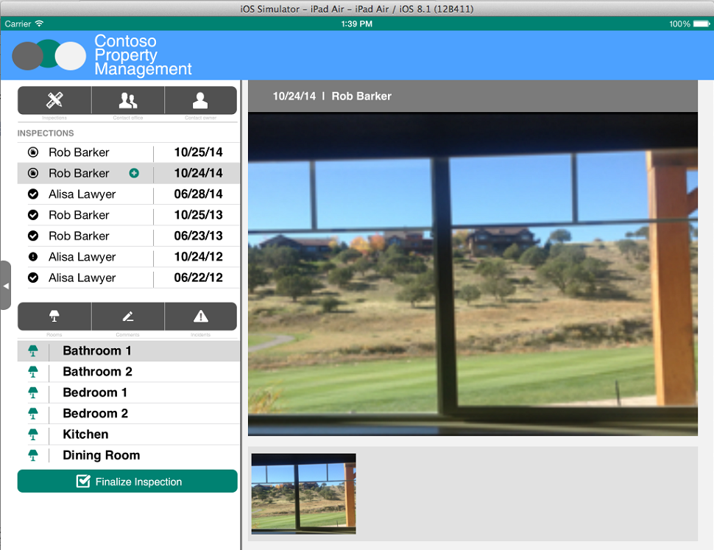
Picture is Uploaded to Room Inspection Photos Document Library and Inspection Comment is created in Inspection Comments List

Slide 16
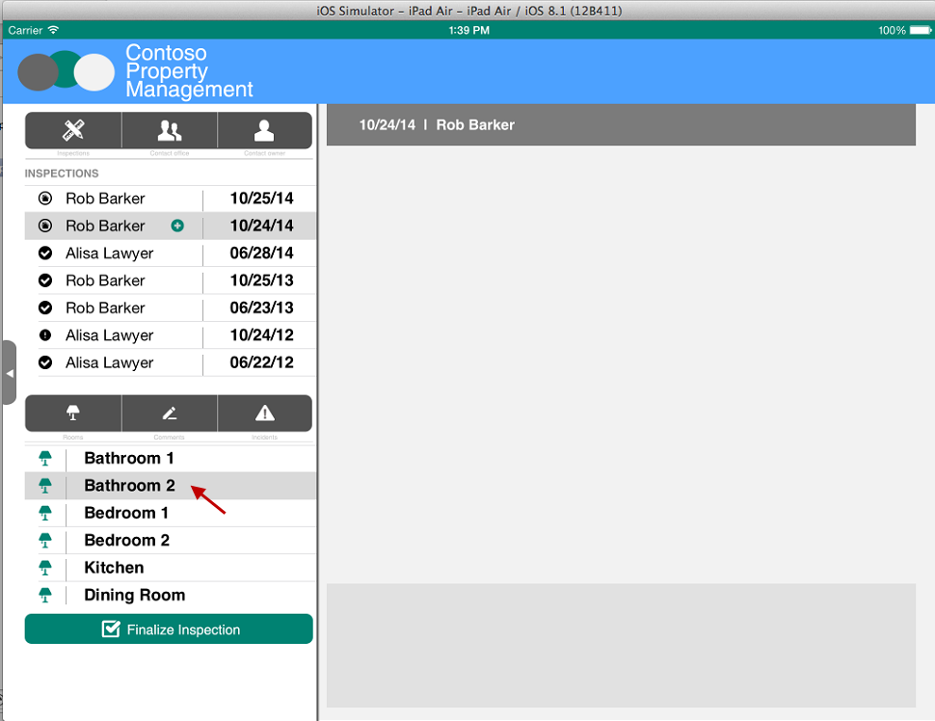
Select Bathroom 2

Slide 17

Click Incidents

Slide 18
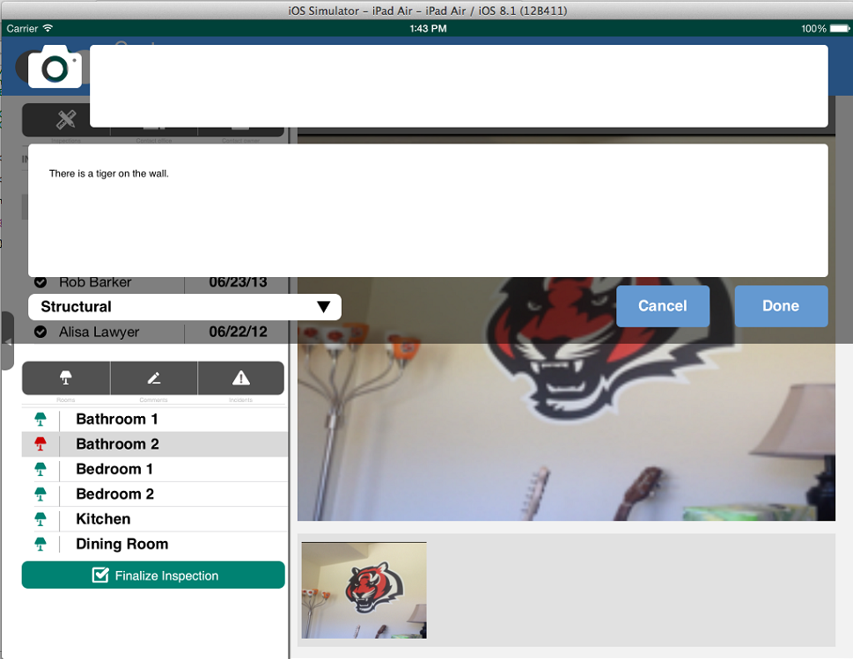
Just like you did in the Inspection Comments popup, take a picture and enter comments. Then, select an Incident Type and click Done.
Incident is created in Incidents List
Photo is added to Room Inspection Photos Library
Workflow Task is created for Dispatcher

Slide 19
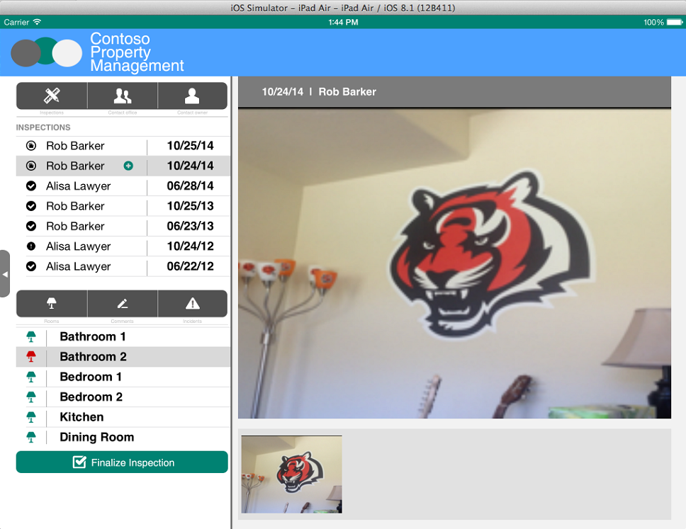
Click Finalize Inspection

Slide 20
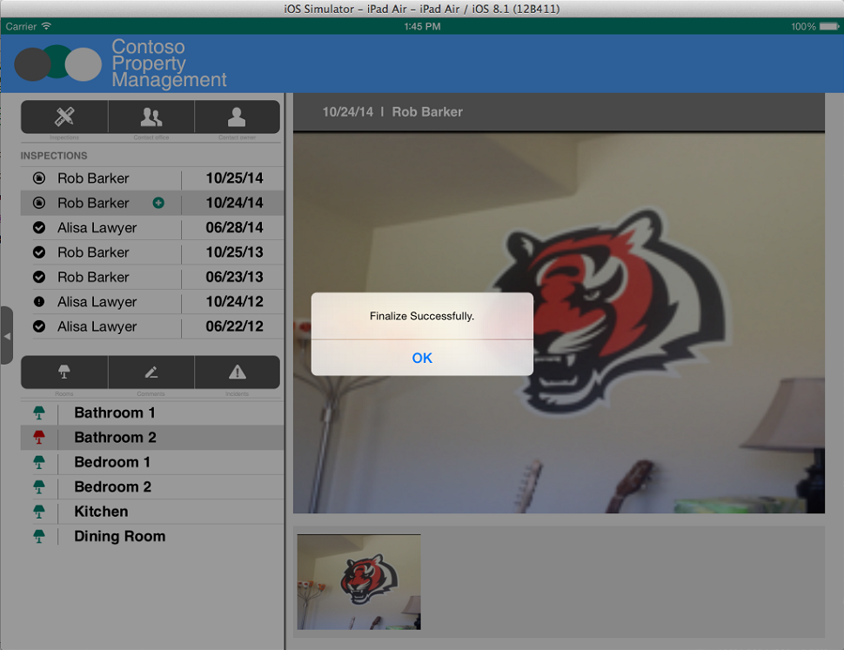
Get Confirmation
Inspection in Inspections list is updated with Finalized Date

Slide 21
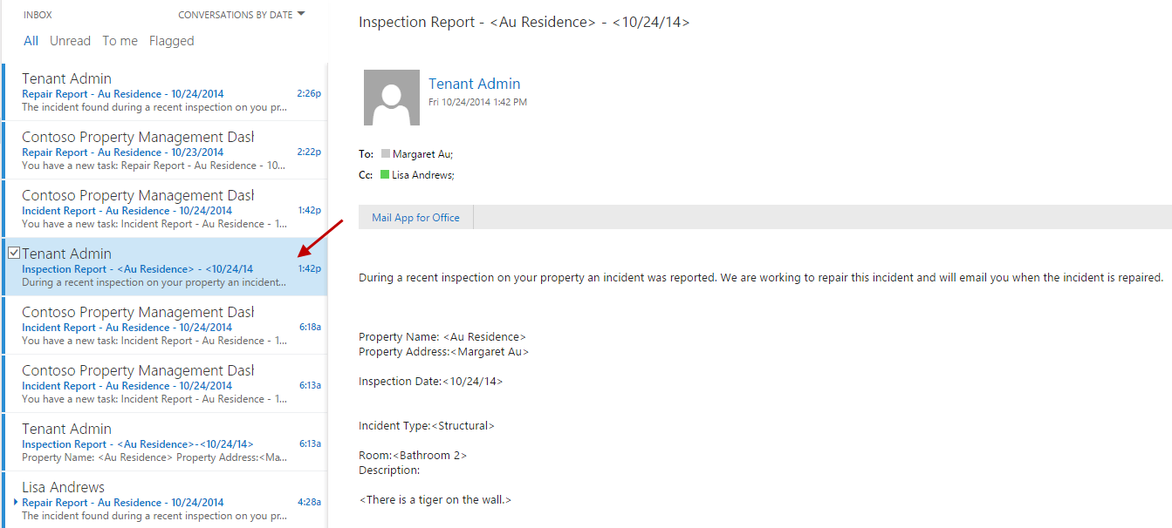
Inspection report email is sent to property owner and dispatcher Log in with Dispatcher account to see the email Username: katiej@<tenanacy>.onmicrosoft.com Password: TempP@ssw0rd! If you have not already signed in with this user you will be prompted to reset the user’s password.

Slide 22
Dispatcher Scheduling Walkthrough

Slide 23
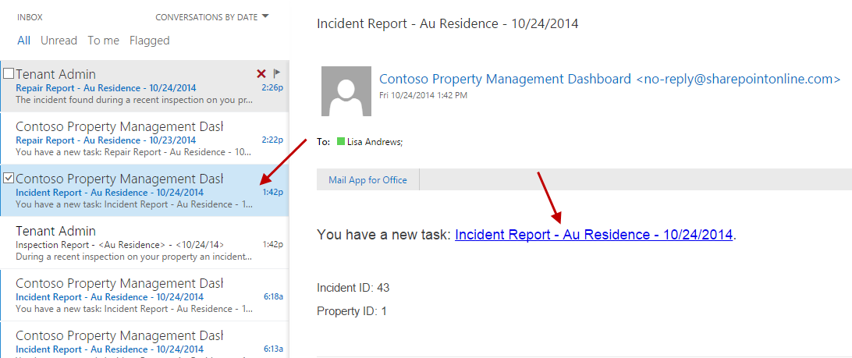
Inspection report email is sent to property owner and dispatcher Log in with Dispatcher account to see the email Username: katiej@<tenanacy>.onmicrosoft.com Password: TempP@ssw0rd! If you have not already signed in with this user you will be prompted to reset the user’s password.

Slide 24
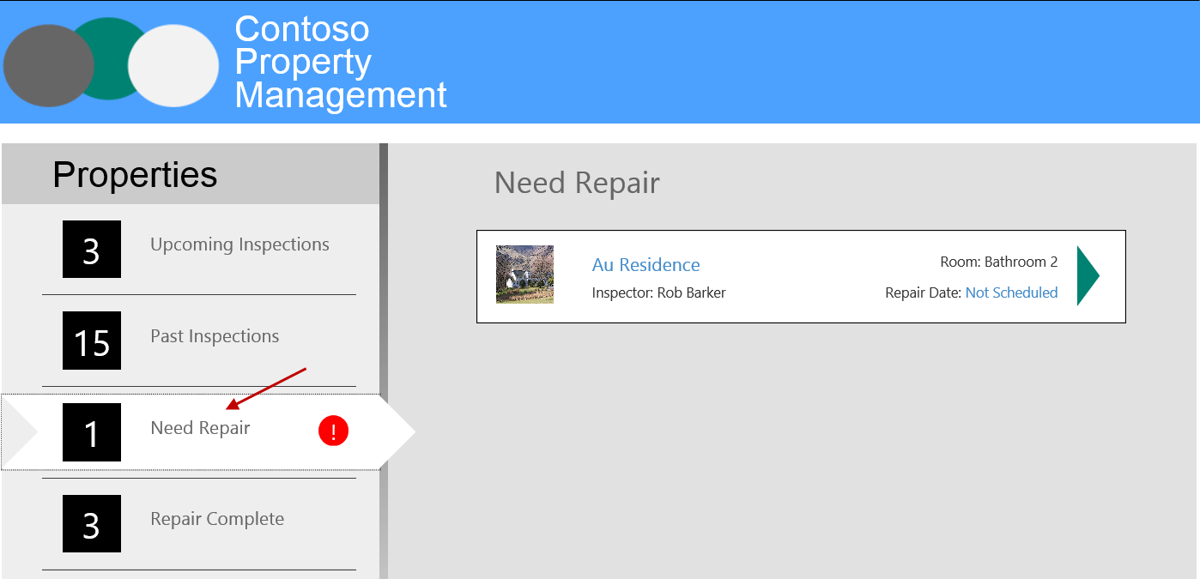
Open Property Management My App Dashboard, click Need Repair

Slide 25
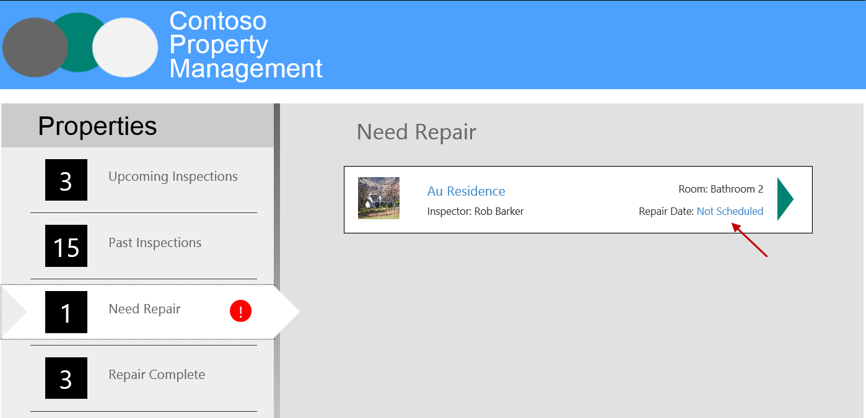
Click Not Scheduled

Slide 26
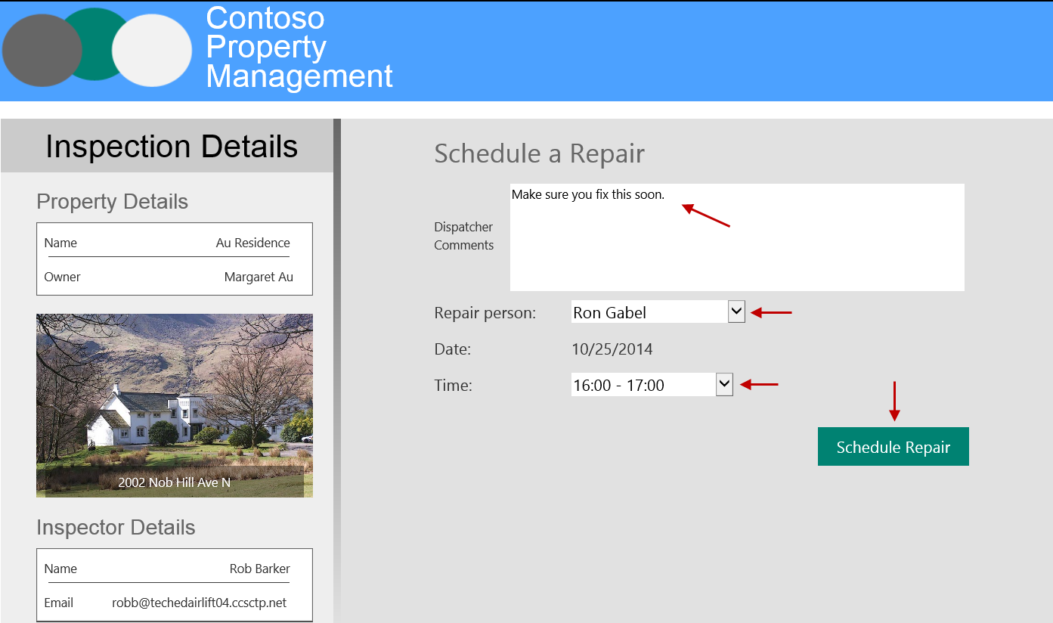
Enter comments, select Ron Gabel, select Time, click Schedule Repair
Incident is updated to reflect Status, Repair Scheduled Date, and Repair Person assigned
Workflow Task for Dispatcher is completed
Workflow Task for Repair Person is created

Slide 27
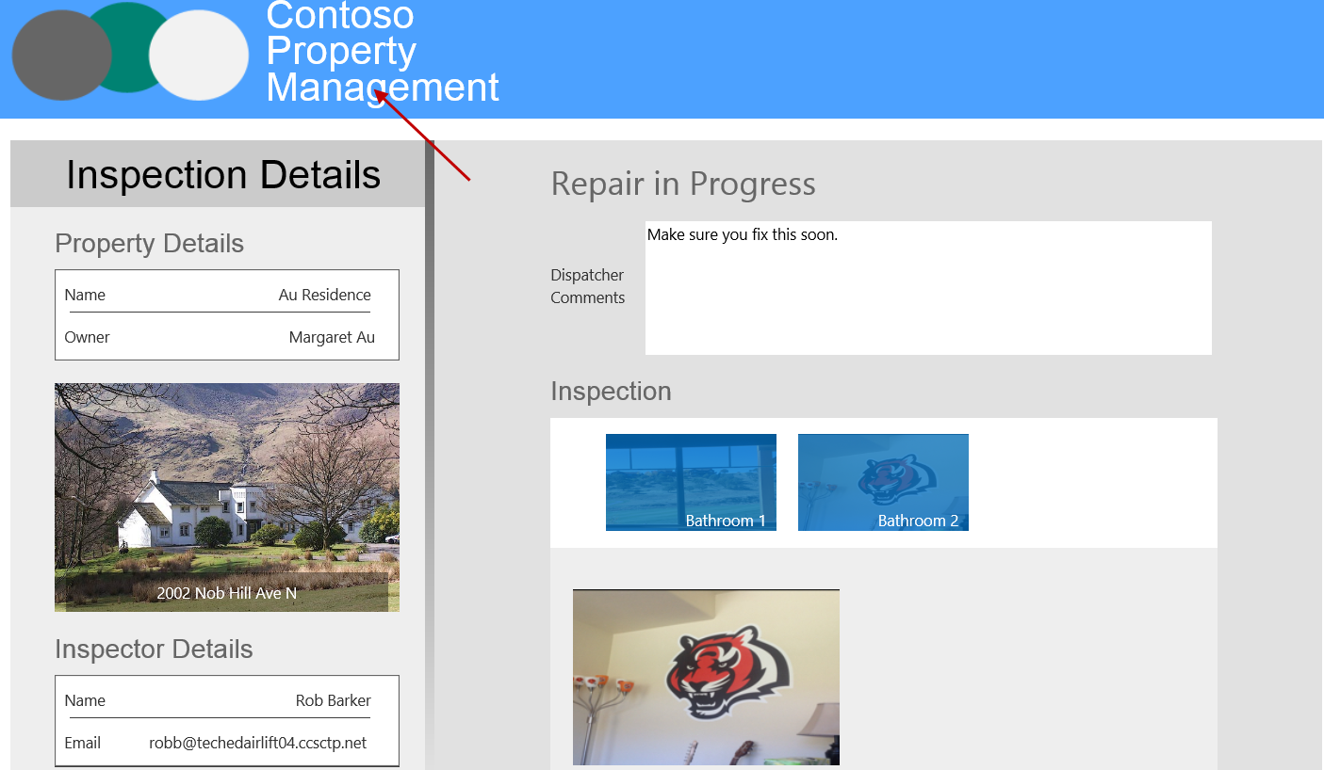
Click the header

Slide 28
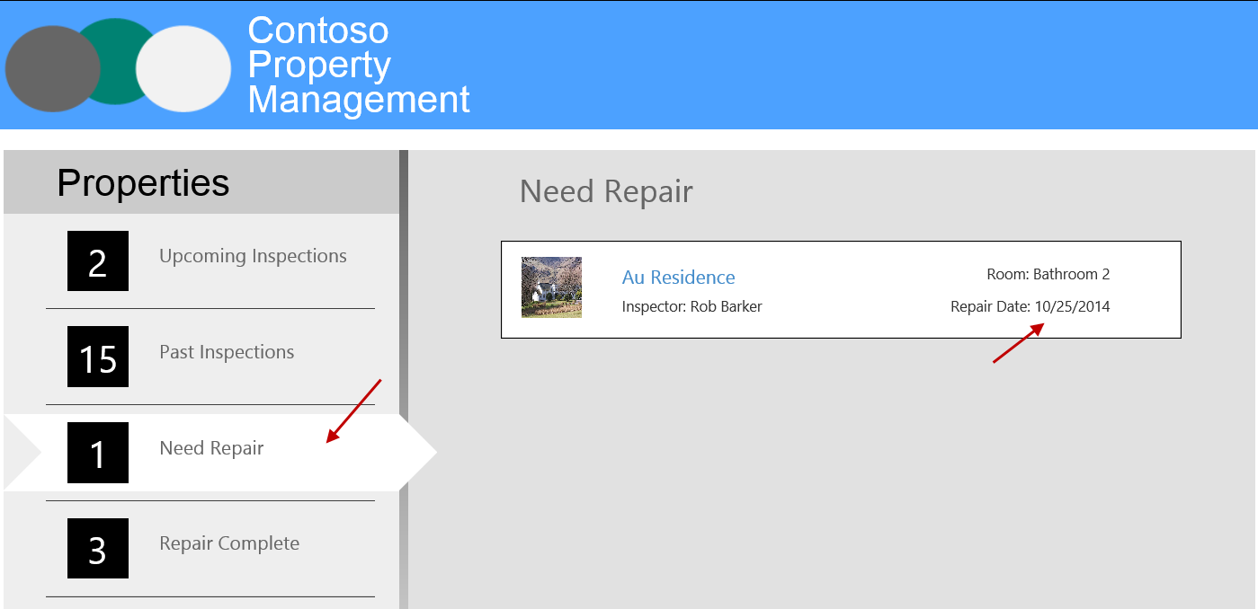
Click Need Repair and mention the repair is scheduled

Slide 29
Repair Walkthrough

Slide 30
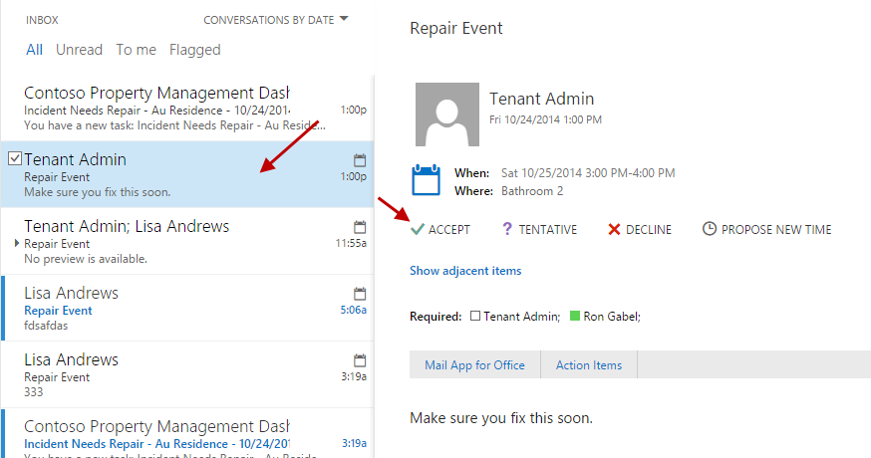
Inspection report email is sent to property owner and dispatcher Log in with Repair Person account to see the email Username: rong@<tenanacy>.onmicrosoft.com Password: TempP@ssw0rd! If you have not already signed in with this user you will be prompted to reset the user’s password.

Slide 31
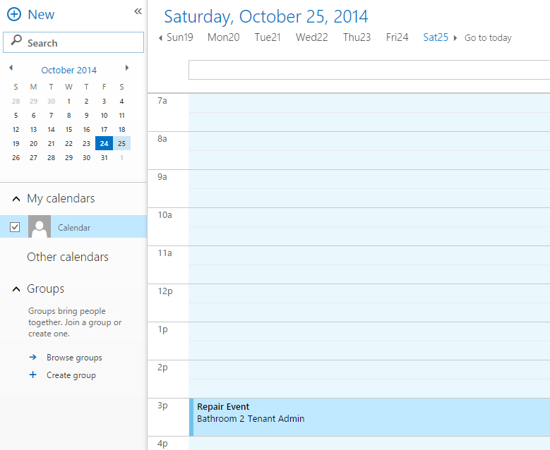
View Calendar Event and Accept It

Slide 32
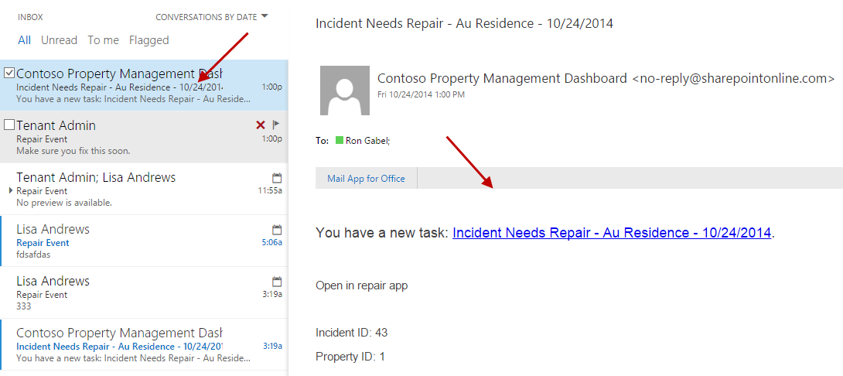
View Repair Task Email sent to Ron Gabel
In order open the Repair iOS app you can click the Open in repair app link when you are viewing this email in the native iOS Mail client.
If you are not using the native iOS Mail client to view the email. Open Safari on your iOS Simulator or your iPad where the app is installed. Enter repairapp://<Incident ID> in the URL textbox and press enter, where <Incident ID> is equal to the Incident ID in the email.
In the example on this slide you would enter repairapp://43 in Safari on your iOS Simulator or iPad.

Slide 33
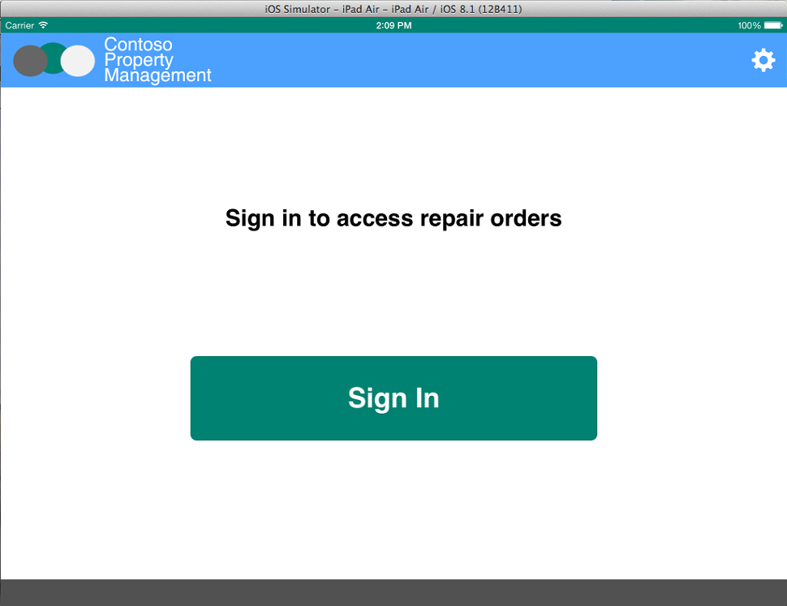
Click Sign In

Slide 34
Enter Inspector Credentials Username: robb@<tennacy>.onmicrosoft.com Password: TempP@ssw0rd! Do not check Keep Me Signed In Click Sign In If you have not already signed in with this user you will be prompted to reset the user’s password.

Slide 35
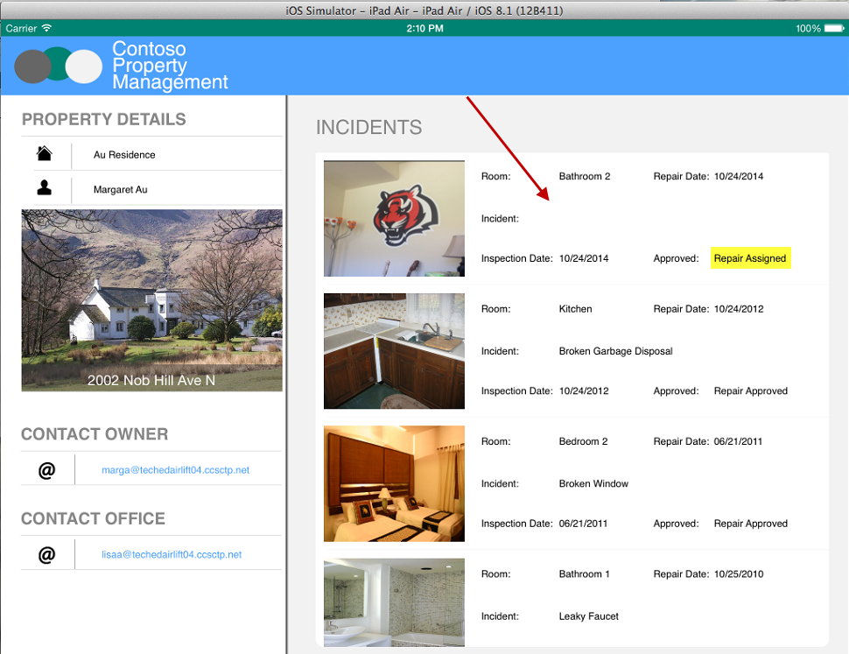
Click the Repair Incident assigned by the Dispatcher

Slide 36
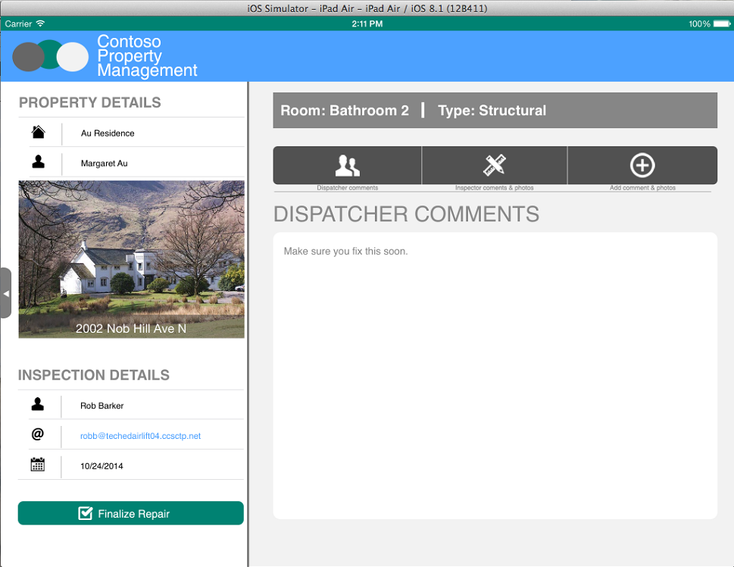
Look at Dispatcher Comments

Slide 37

Click Inspector Comments and Photos

Slide 38
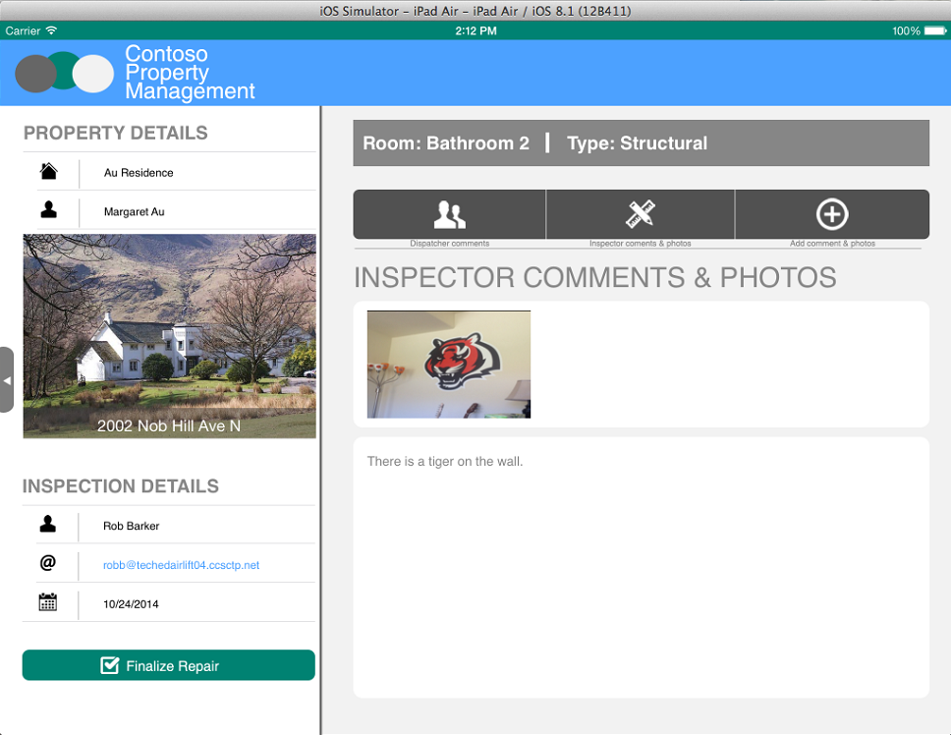
Look at Inspector Comments

Slide 39
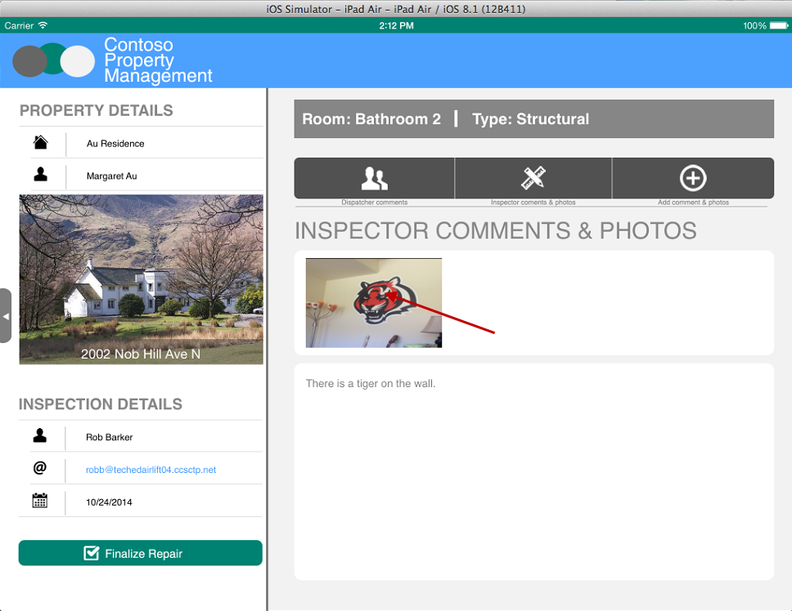
Click Photo

Slide 40
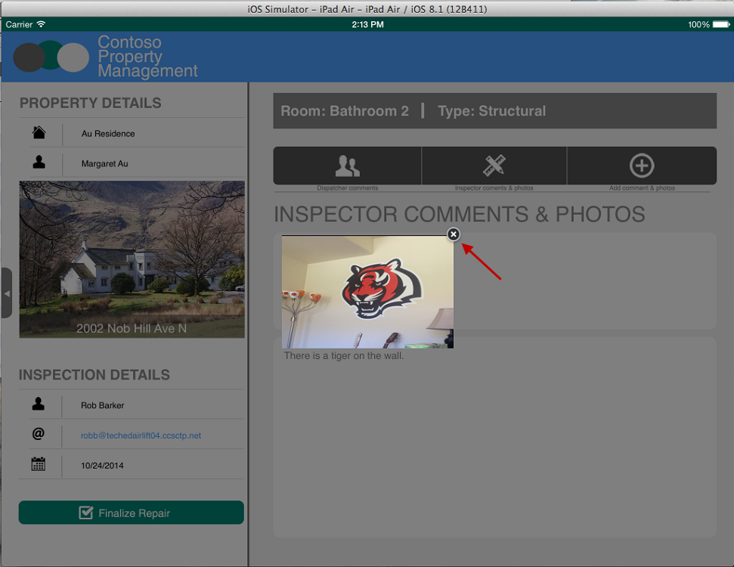
View Photo Full Size, Click X to Close

Slide 41
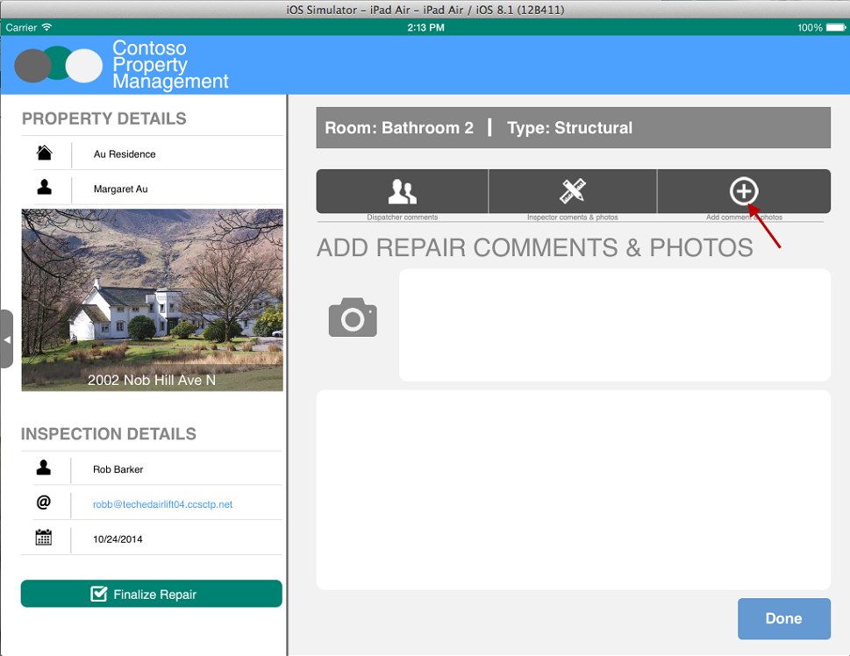
Just like you did in the Inspection App, take a picture and enter comments. Then, tap Done.

Slide 42
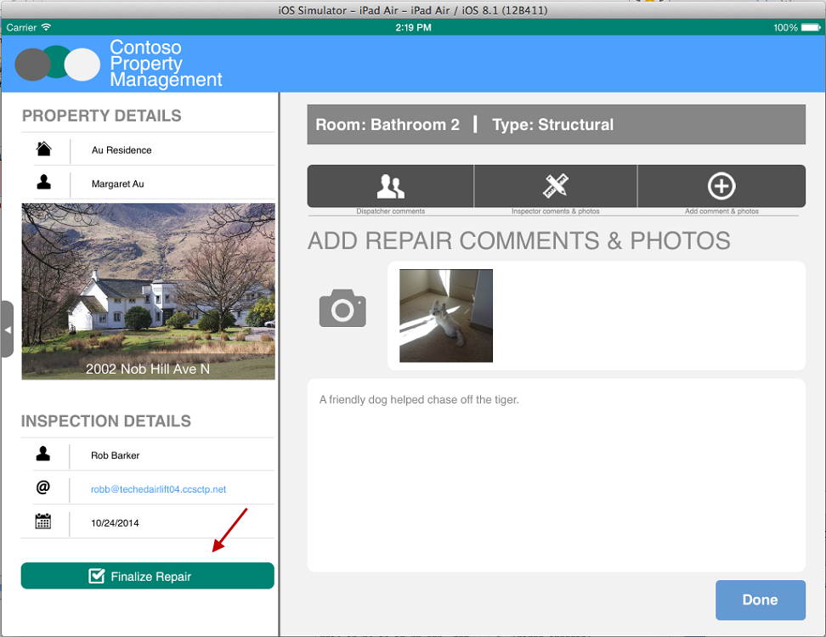
Click Finalize Repair
Incident list updated with Repair comments, Status, and Repair Completed date
Photo is added to Repair Photos Library
Workflow Task for Repair Person is completed
Workflow Task for Dispatcher is created

Slide 43
Approve Repair Walkthrough

Slide 44
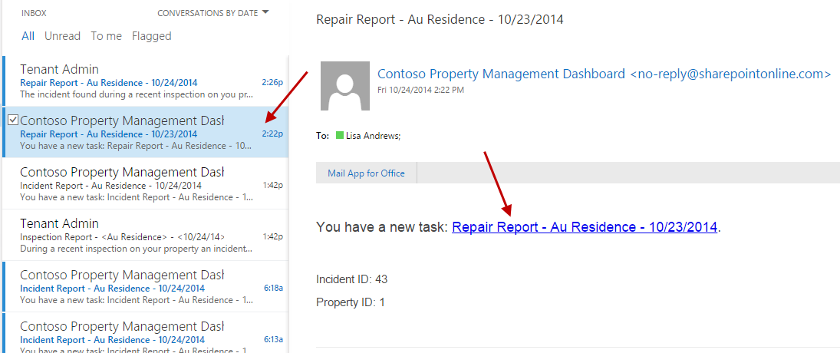
Email is sent to Dispatcher to approve repair. Log in with dispatcher to view email. Username: katiej@<tennacy>.onmicrosoft.com Password: TempP@ssw0rd!

Slide 45
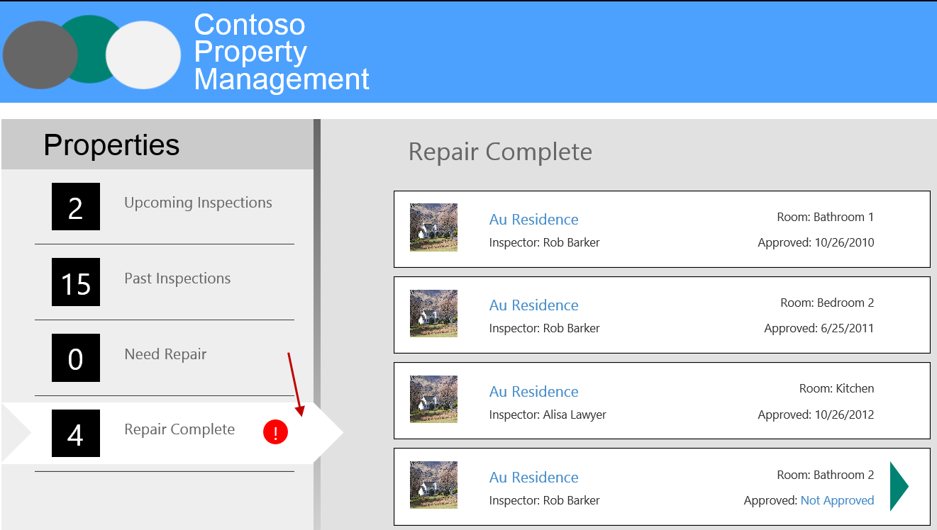
Refresh Property Management My App and click Repair Complete

Slide 46
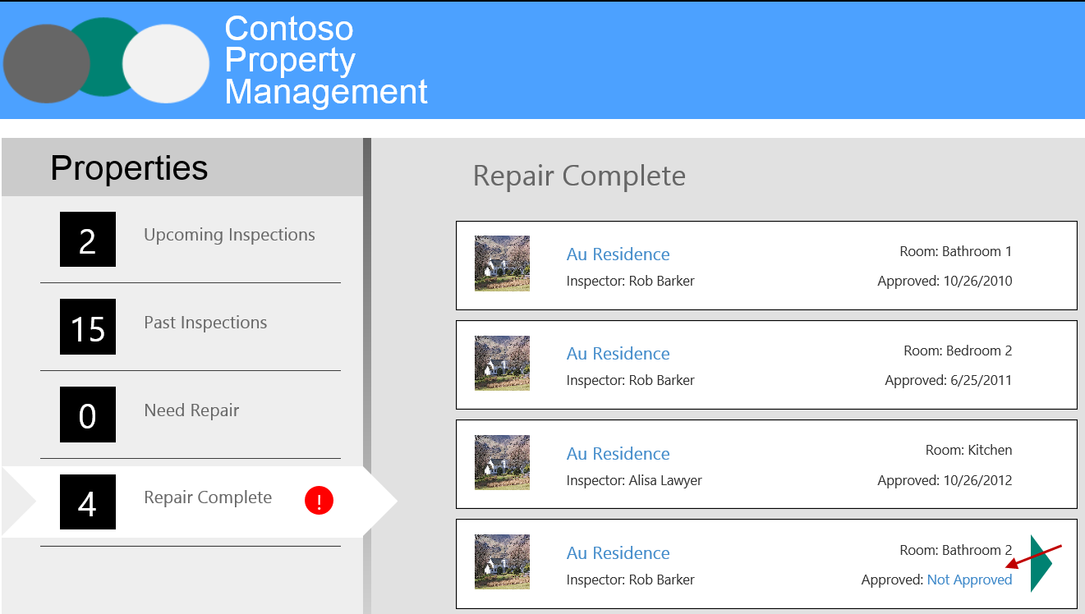
Click Not Approved

Slide 47
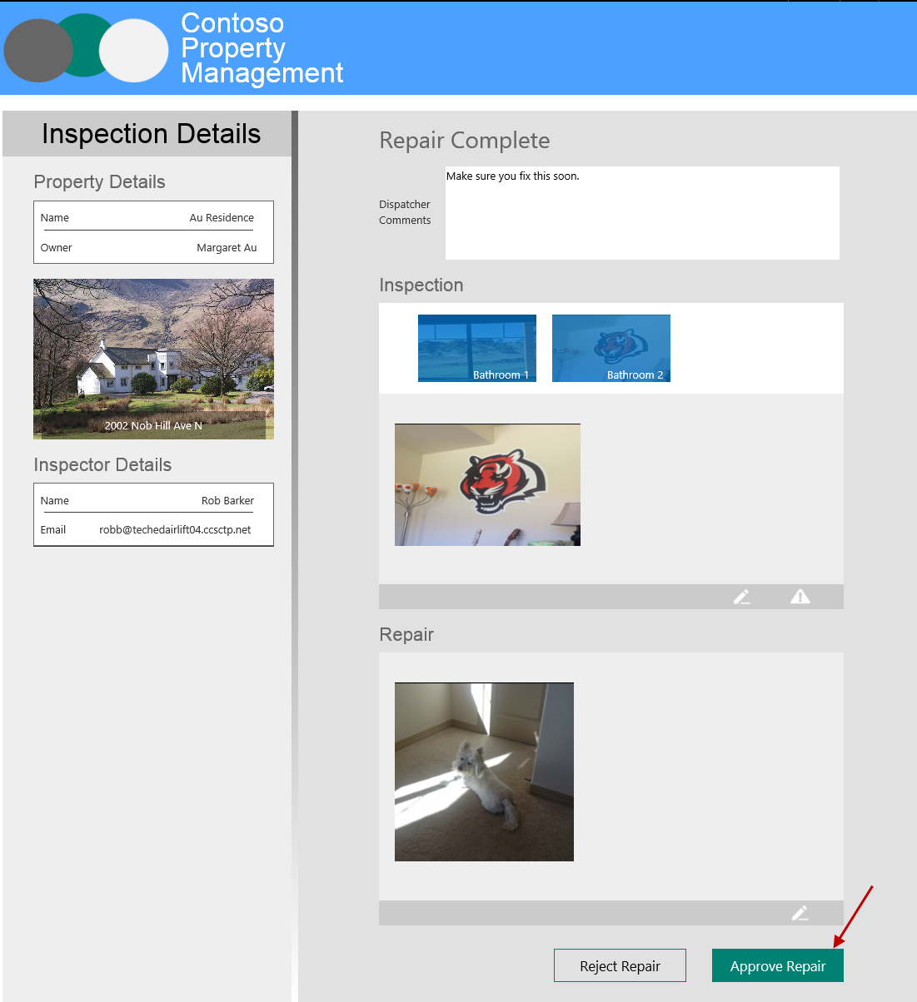
Browse all data and images and click Approve Repair
Workflow Task for Dispatcher is completed
Incident is updated with Repair Approved Status and Date
Workflow History is updated to close workflow

Slide 48
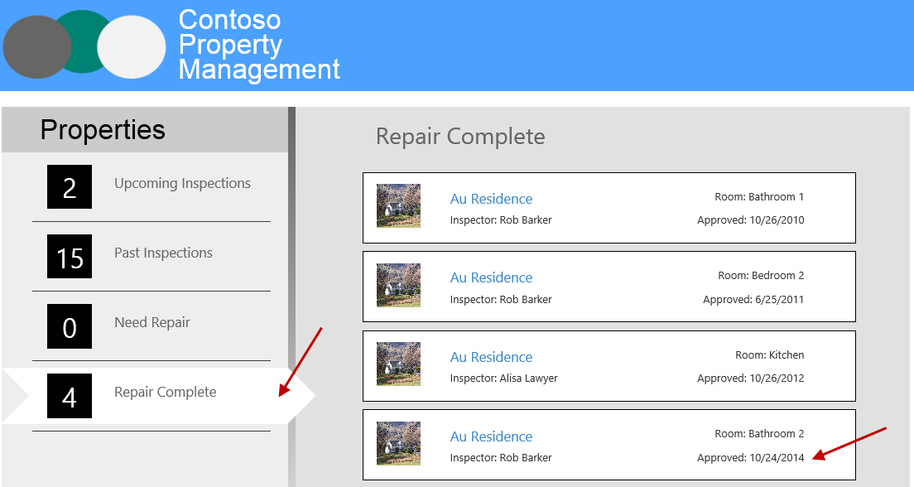
Refresh Property Management My App and click Repair Complete to see completed status

Slide 49
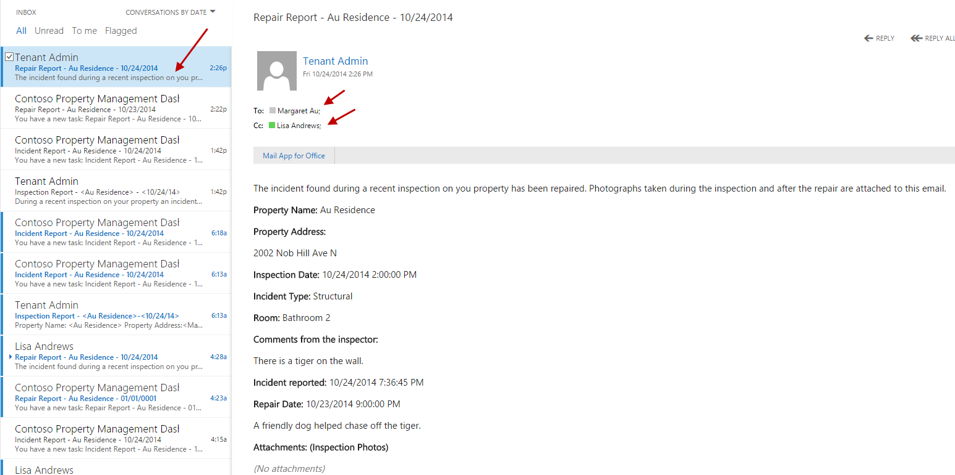
Email is sent to Dispatcher to approve repair. Log in with dispatcher to view email. Username: katiej@<tennacy>.onmicrosoft.com Password: TempP@ssw0rd!

